Slide 1
Vascular Disease Prediction
Shreyanshi Khandelwal (RA1911003010581)
Abhyudaya Lohani (RA1911003010576)
Dhawal Patil (RA1911003010575)

Slide 2
Problem Statement
The health care industries collect huge amounts of data that contain some hidden information, which is useful for making effective decisions. For providing appropriate results and making effective decisions on data, some advanced data mining techniques are used. In this project, a Vascular Disease Prediction System (VDPS) is developed using Naives Bayes and Decision Tree algorithms for predicting the risk level of heart disease. The system uses 13 medical parameters such as age, sex, blood pressure, cholesterol, and obesity for prediction. The VDPS predicts the likelihood of patients getting heart disease. It enables significant knowledge. E.g. Relationships between medical factors related to heart disease and patterns, to be established.

Slide 3
Purpose of the Problem Statement
AI techniques such as machine learning, deep learning, and cognitive computing have the potential to change the way in which cardiology and cardiovascular medicine are practiced (e.g., how we generate knowledge, interpret data, and make decisions), especially in cardiovascular imaging. The primary objective is to predict the disease with a smaller number of attributes.

Slide 4
Description
1. Data Cleaning: After importing the dataset, we resorted to cleaning it. This means we checked for null values, duplicate values, skewness etc. and looked for ways to remove them.
2. Exploratory Data Analysis: We used scatterplots and boxplots to check for outliers. And, therefore did univariate, bivariate and multivariate analysis on the dataset to plot different kinds of graphs.
3. Pre Processing: The target variable "output" was set as y variable. And, all other columns were set as x variable. Testing size = 0.25 and training size = 0.75

Slide 5
Description
4. Deployment:. For classification, we used different kinds of models like Logistic Regression, Random Forest, Decision Tree, SVM, Naive Bayes.
5. Hyperparameter Tuning: To further improve the efficiency of the models, we did hyperparameter tuning. Thus, choosing only the optimal parameters for calculating the accuracy. Grid Search CV was the most apt method since the dataset wasn't very large and less number of columns were used.
6. Feature Importance: To identify the most obvious symptom that leads to this vascular disease, we performed feature importance and calculated scores for all the columns.

Slide 6
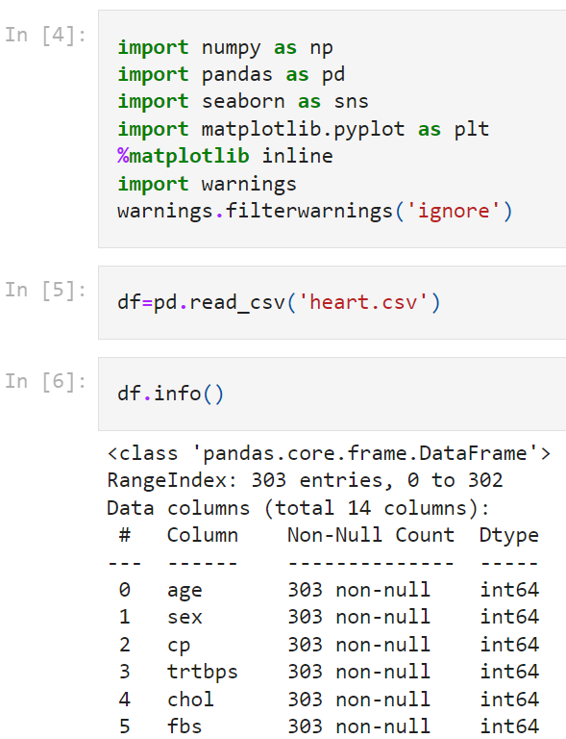
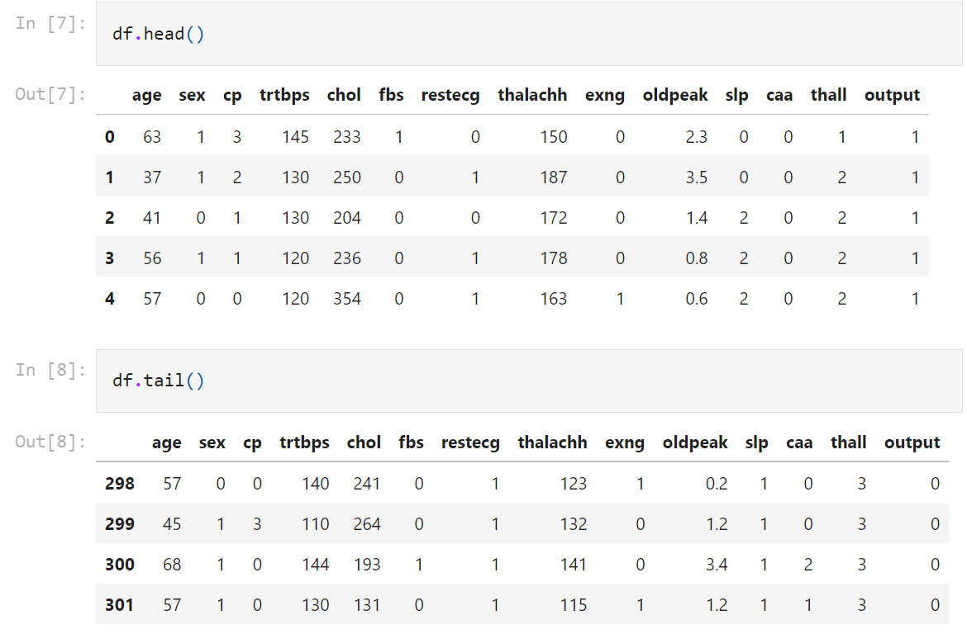
Code

Slide 7
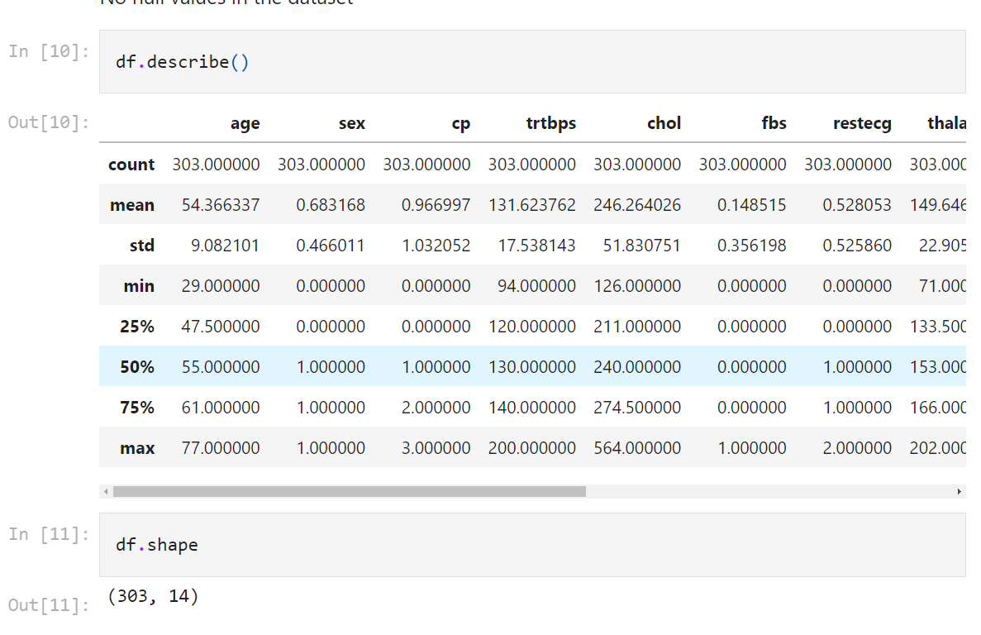
Code

Slide 8
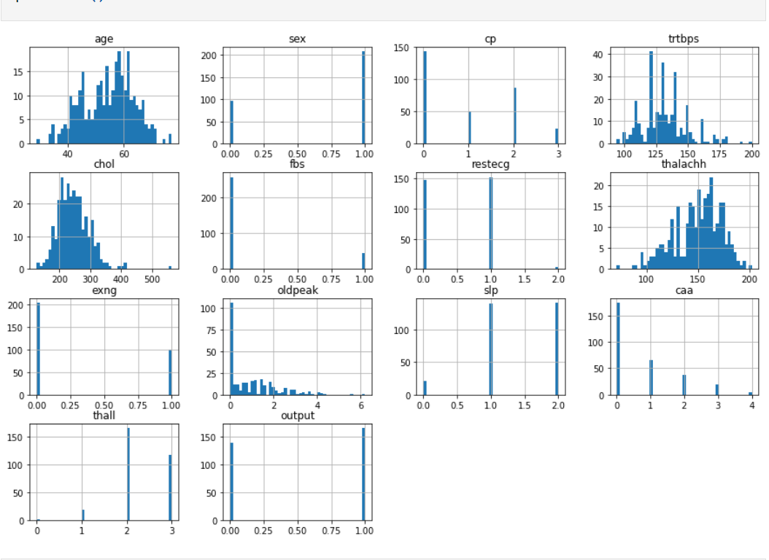
Code

Slide 9
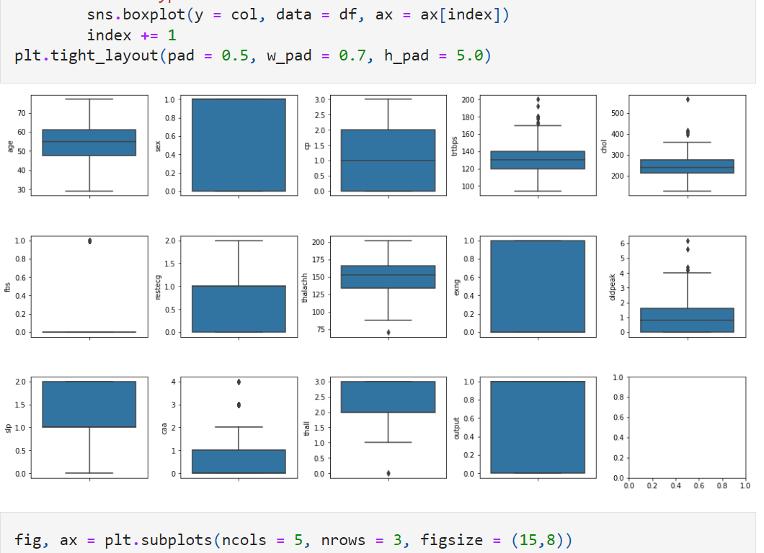
Code

Slide 10
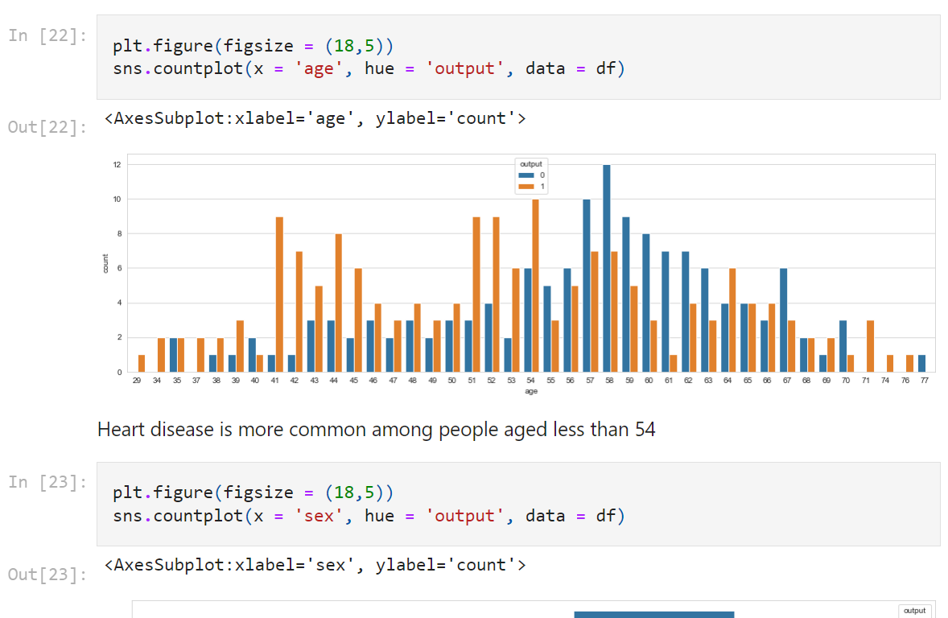
Code

Slide 11
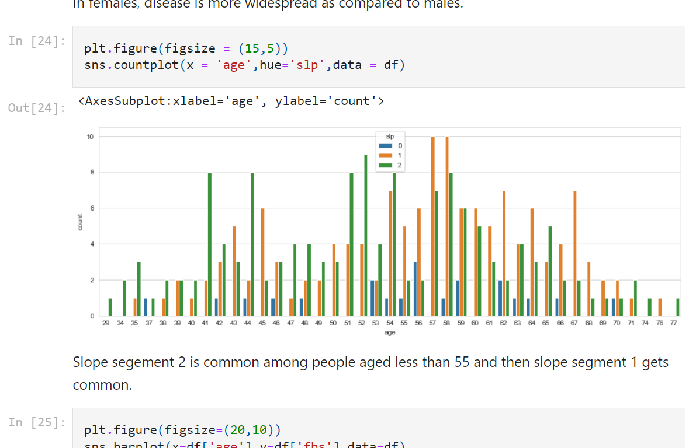
Code

Slide 12
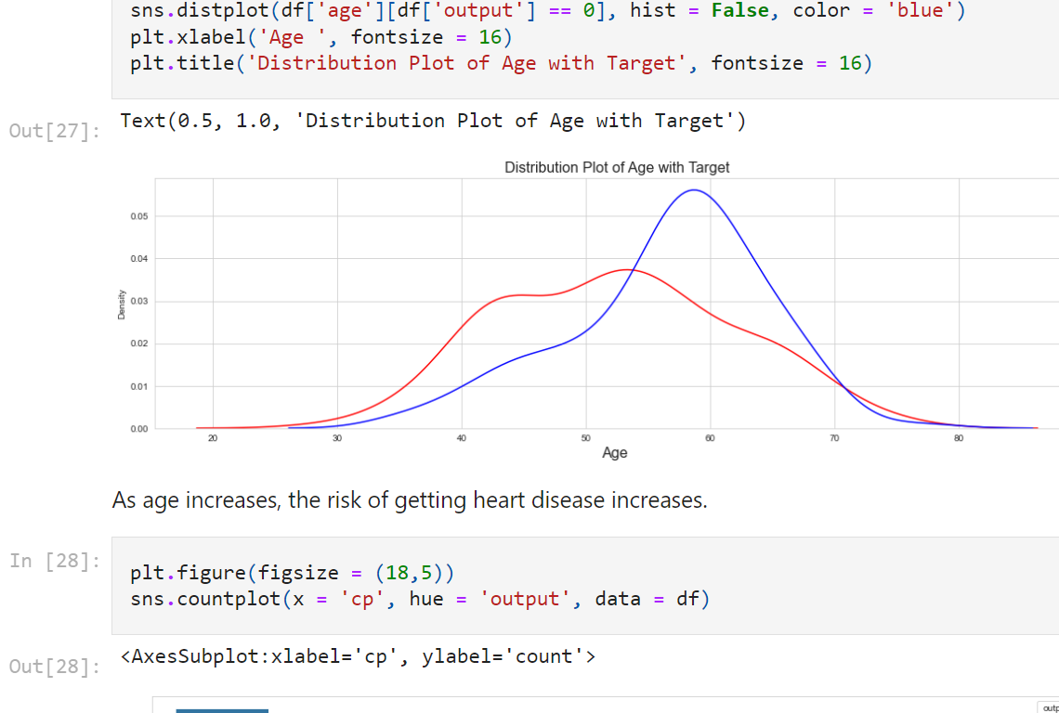
Code

Slide 13
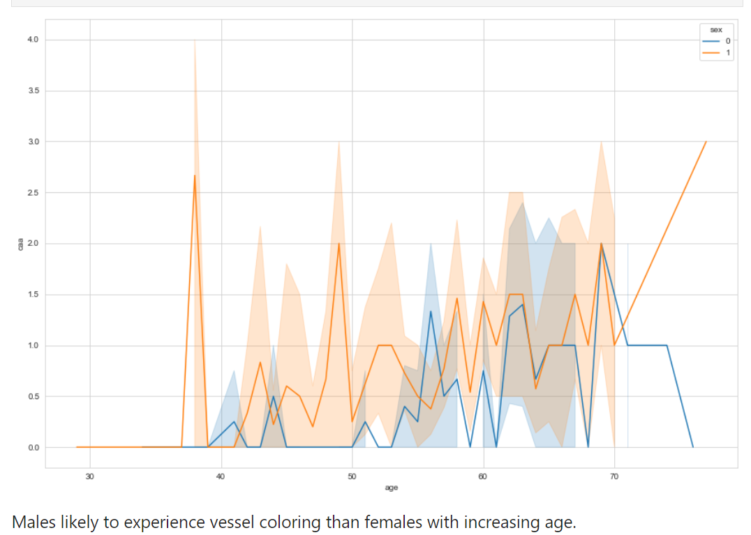
Code

Slide 14
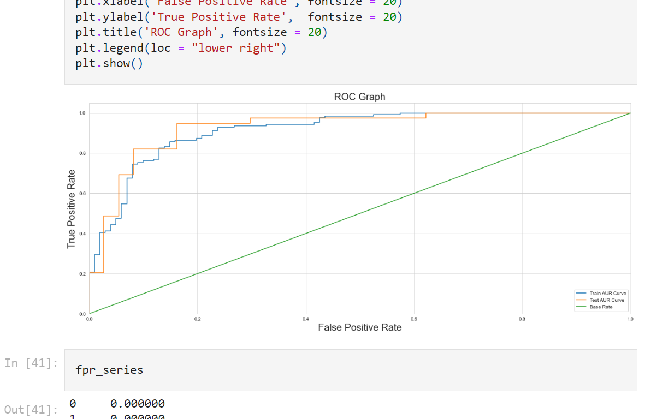
Code

Slide 15
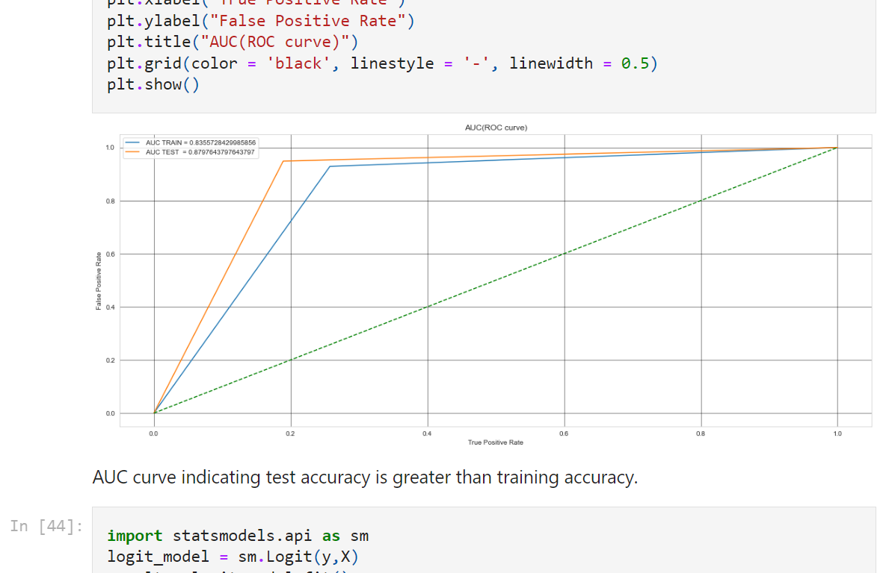
Code

Slide 16
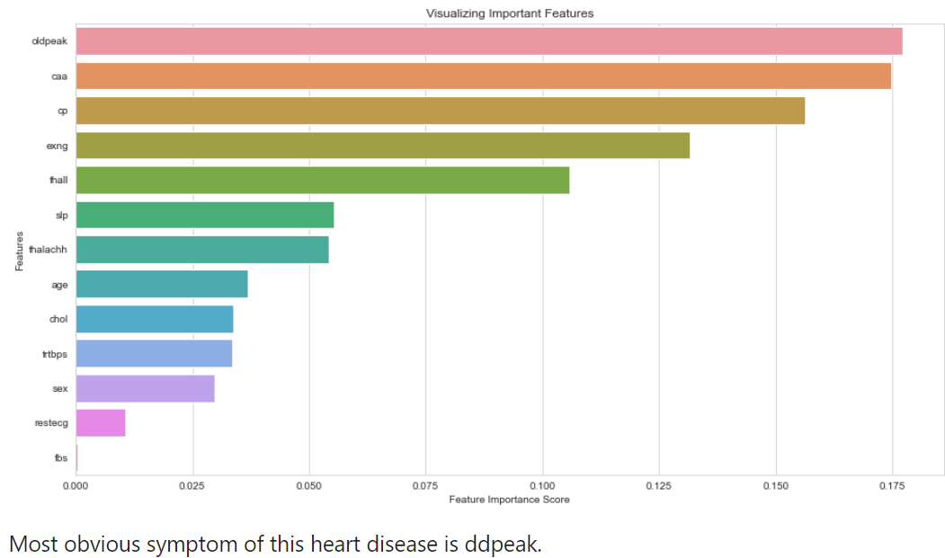
Code

Slide 17
Conclusion
Cardiovascular disease is more common among females than males.
People aged less than 54 years are more likely to suffer from this.
Slope segment 2 is common among people aged less than 55 and then slope segment 1 gets common
People aged less than 42 have very low chances of having high blood sugar level.
As people grow older(especially after 40), they should start taking care of their cholestrol and blood sugar levels.
Vessel coloring usually stars after age 40.
Chest pain type 0 most common among people not suffering from heart disease.
Males likely to experience vessel coloring than females with increasing age.
People with cp>0 more likely to suffer from this heart disease.
Females less likely to have vessel coloring 4.

Slide 18
Thank You

